Slide 1
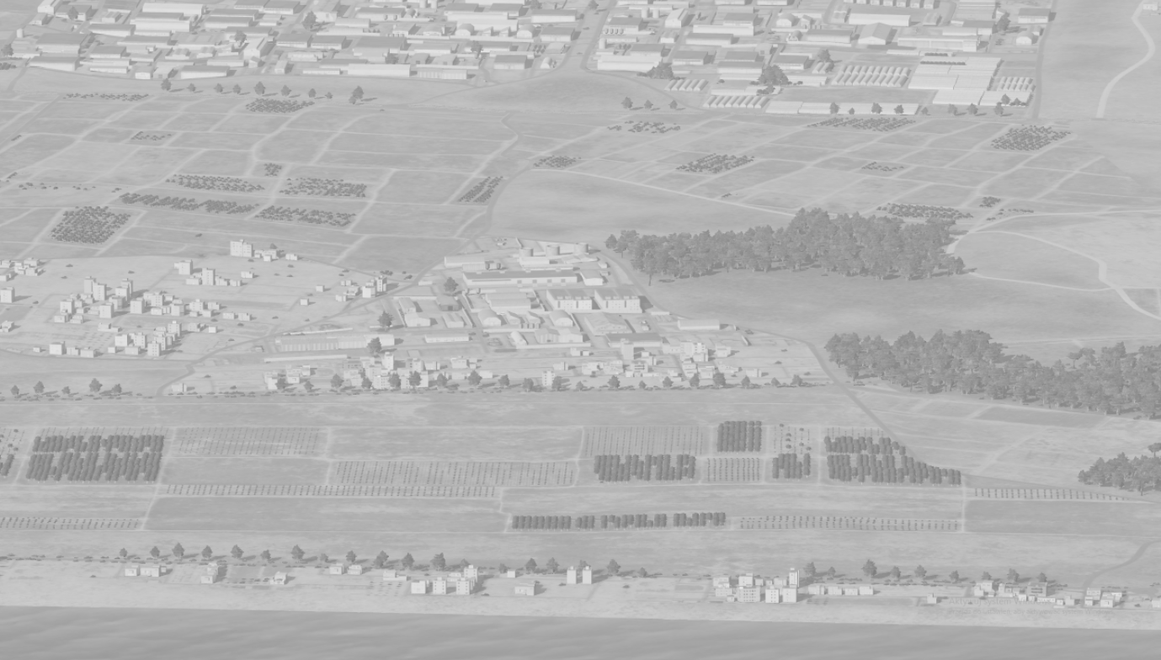
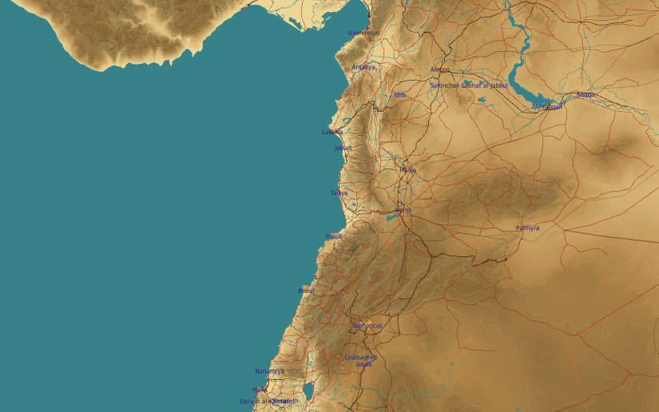
OPARTGT021 Vehicle Factory
N
5-8
3-4
1-2
21
Assembly Plant
DESCRIPTION OF THE DESIRED POINTS OF IMPACT WITH WPN TYPE:
OPARTGT021A – Production Hall
DPI 1 N34 50.958 E 035 54.560/82ft/(1000 Ibs bomb)
DPI 2 N34 50.977 E 035 54.575/82ft /(1000 Ibs bomb)
OPARTGT021B – Production Hall
DPI 3 N34 50.944 E 035 54.576/76ft /(1000 Ibs bomb)
DPI 4 N34 50.953 E 035 54.591/81ft /(1000 Ibs bomb)
OPARTGT021C – Assembly Plant
DPI 5 N34 51.000 E 035 54.652/114ft /(1000 Ibs bomb)
DPI 6 N34 51.013 E 035 54.616/ 113ft /(1000 Ibs bomb)
DPI 7 N34 51.028 E 035 54.605/112ft /(1000 Ibs bomb)
DPI 8 N34 51.042 E 035 54.594/110ft /(1000 Ibs bomb)
Production Hall
4
5
6
Residential areas N and W of the facility within 200m.
7
8

Slide 2
OPARTGT021 Vehicle Factory DPIs
N
OPARTGT021C
7
6
5
8
1
2
4
1
3
OPARTGT021A
OPARTGT021B
OPARTGT021A/B – 3 storey buildings made of concrete slab supported by reinforced concrete base and pillars, flat poured roof, requires delayed fuzing.
Suggested fuzing solution on DPIs 1-4 – contact to open up the roof followed by delayed to pierce through floors and affect building structure.
OPARTGT021C – single hall, walls made of slabs, poured roof supported by metal frame and reinforced concrete pillars. Requires delayed fuzing.

